Slide 1
Summary master Easter 2020
Ivar Svalheim Haugerud

Slide 2
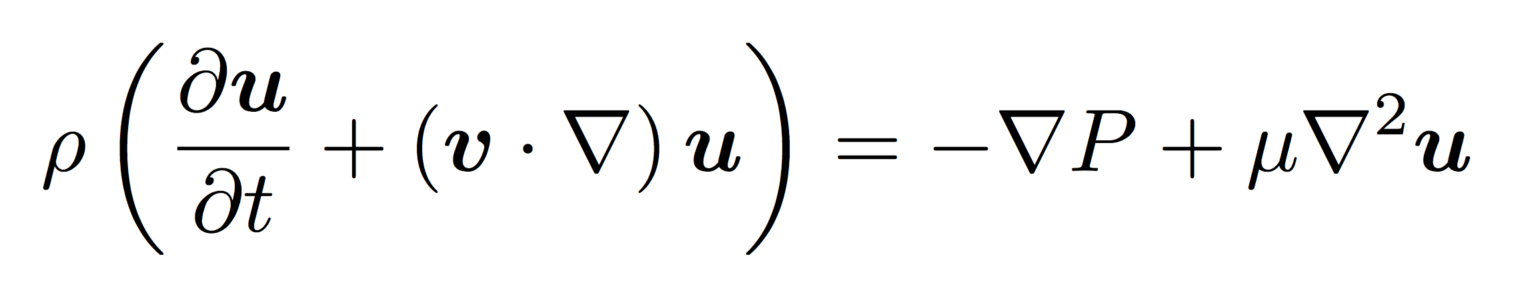
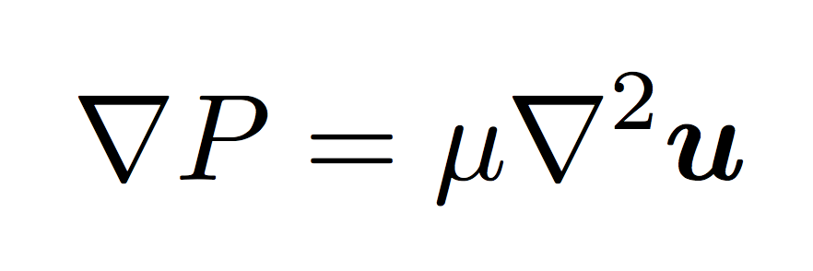

Solving Navier-Stokes

Slide 3
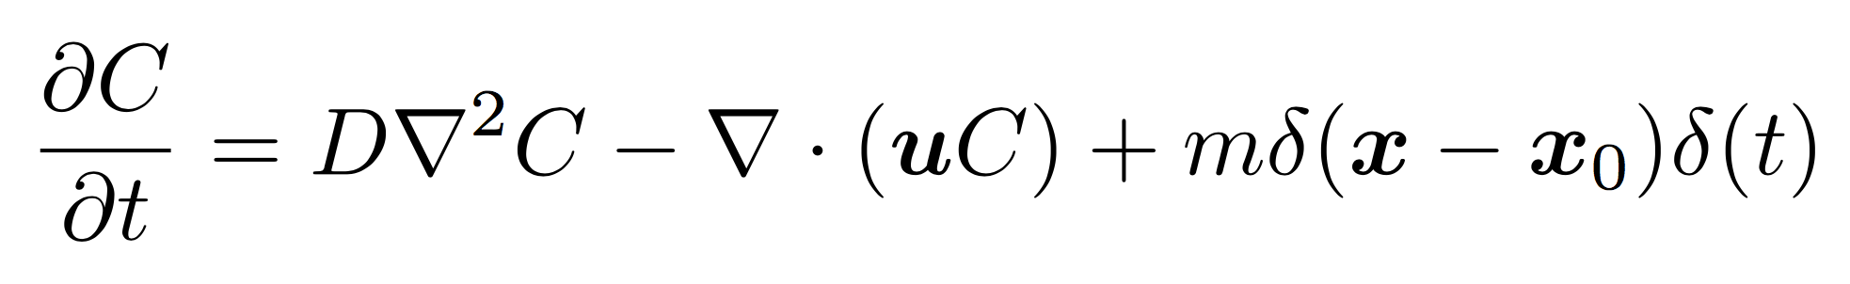
Reciprocal relation

Slide 4
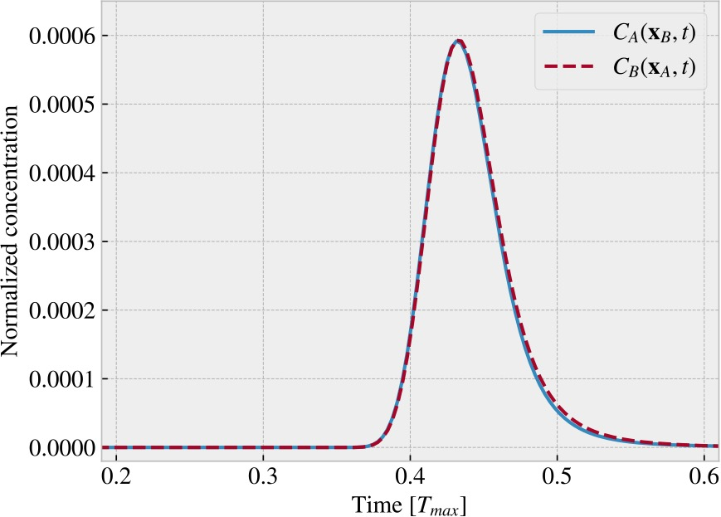
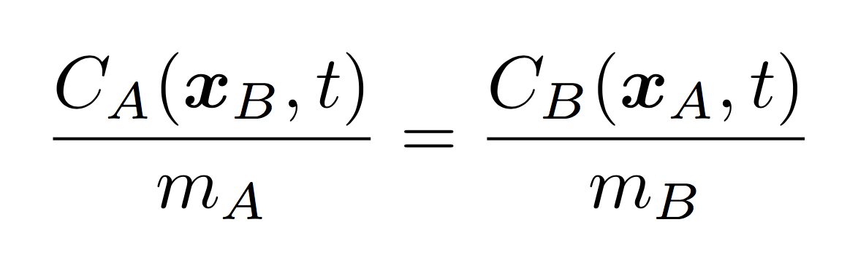
Reciprocal relation

Slide 5
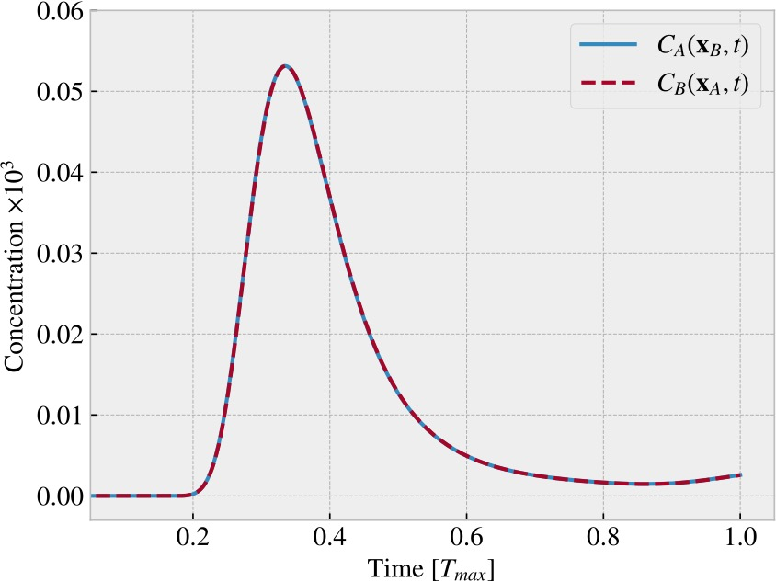
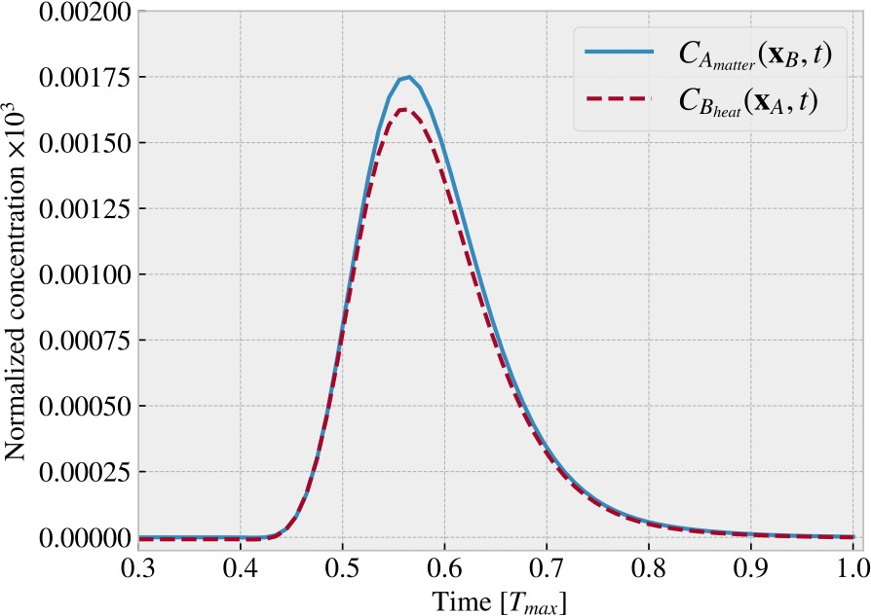
Thermal diffusion
Heat both ways: Re = 3.8*1e-4, Pe = 9.7
Heat one way, matter the other:
Re = 2.4*1e-3, Pe = 60.3.
Differenet boundary conditions, heat not conserved

Slide 6
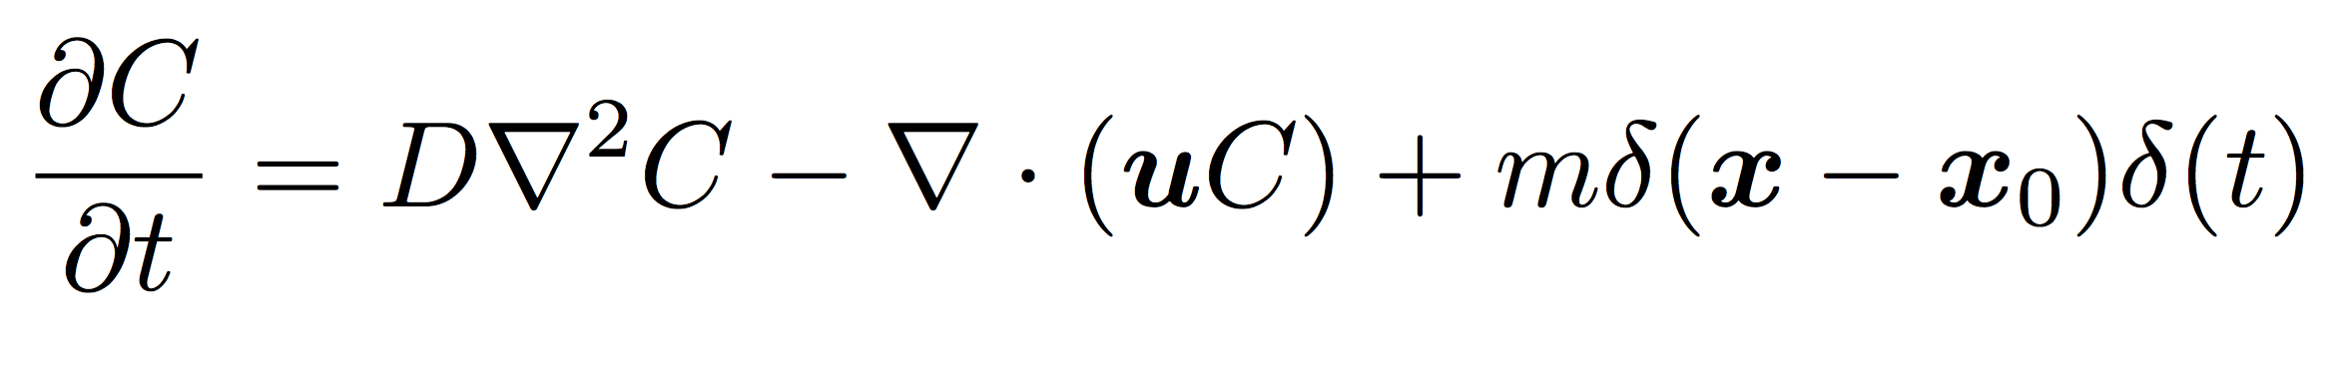
Constant Peclet number

Slide 7
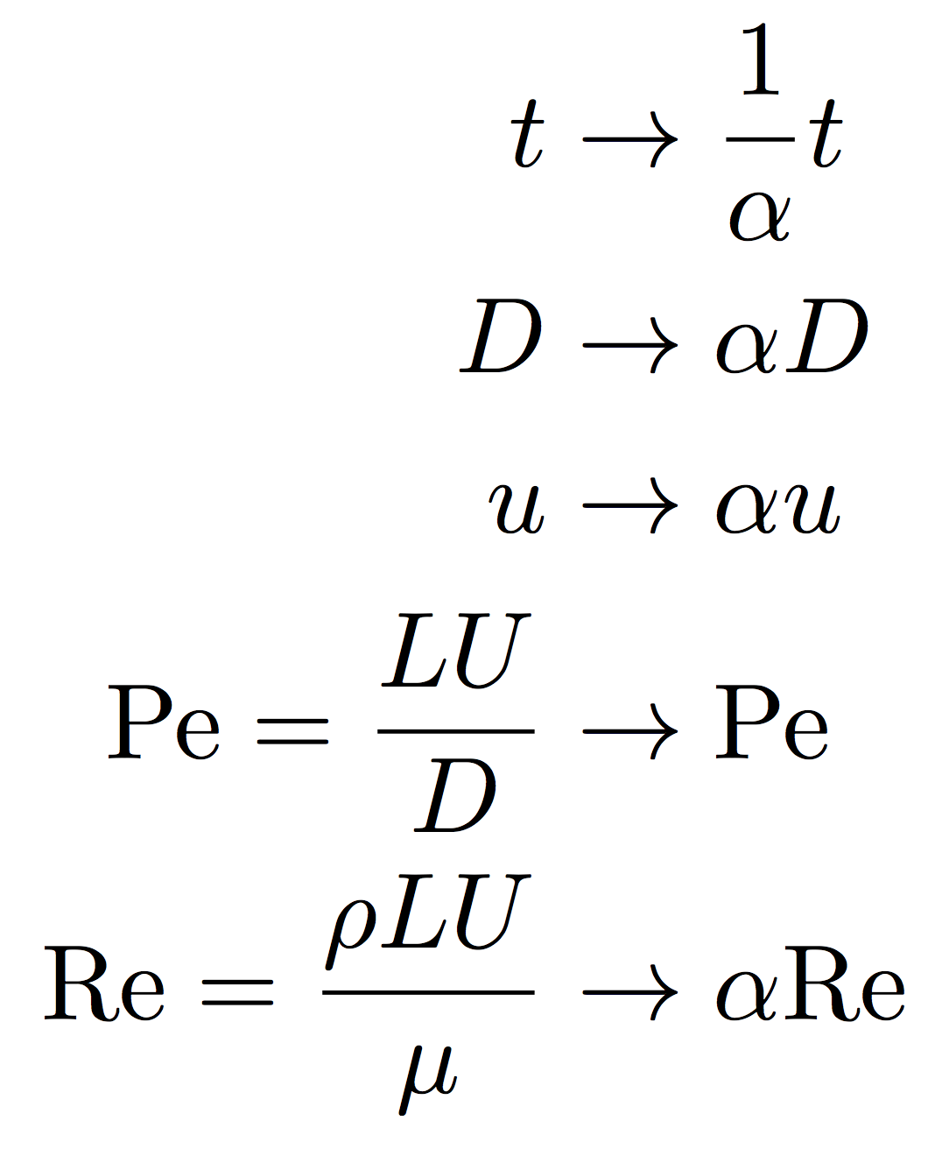
Constant Peclet number

Slide 8
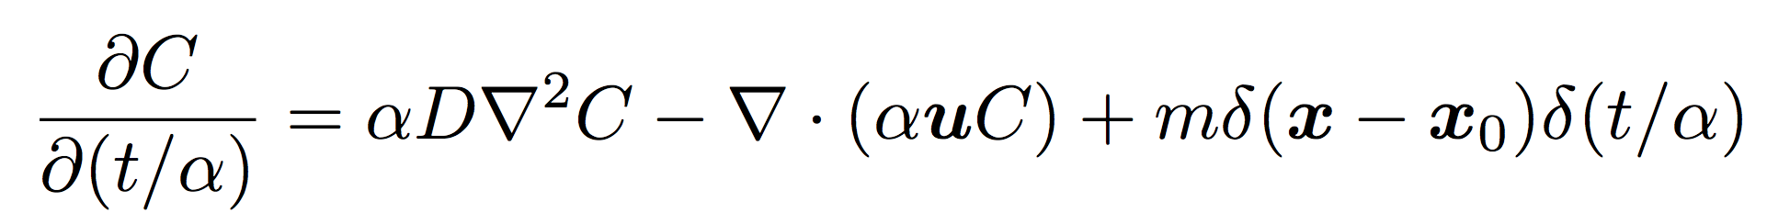
Constant Peclet number

Slide 9
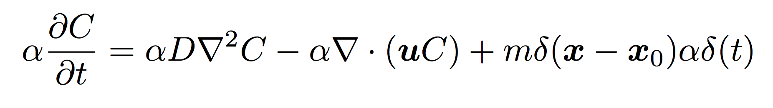
Constant Peclet number
All function are linear in time, a constant scaling does not effect the equation

Slide 10
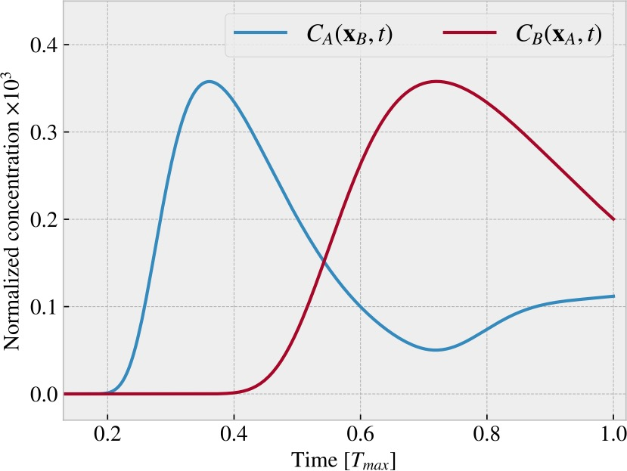
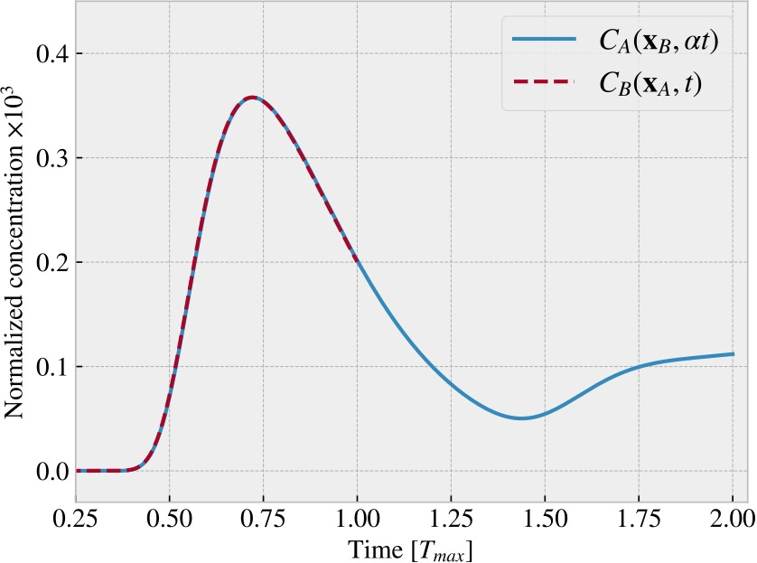
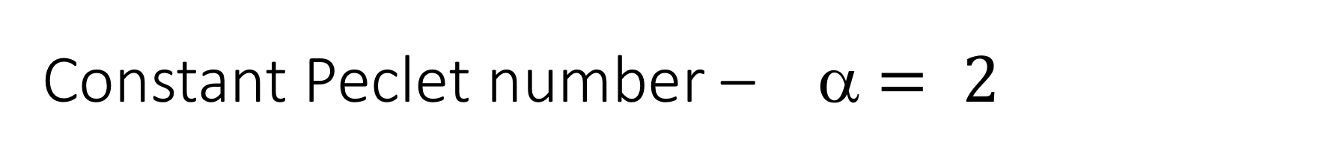
Constant Peclet number – α $= 2$

Slide 11
Maximizing concentration

Slide 12
Maximizing concentration

Slide 13
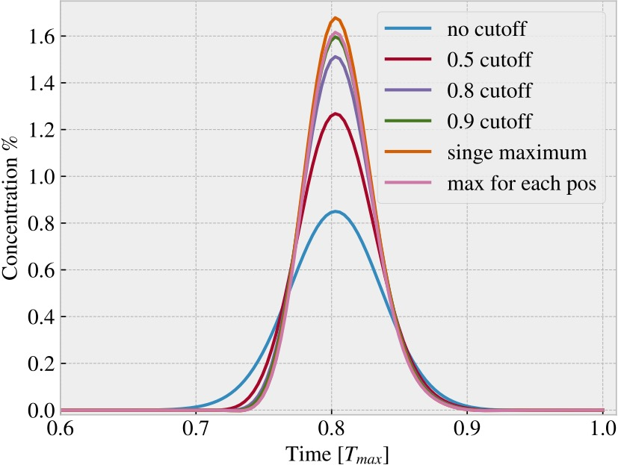
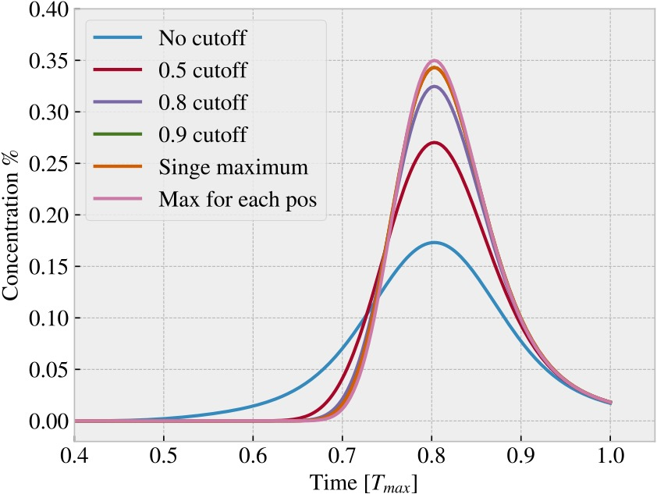
Maximizing concentration
Pe = 150,
Different injection methods optimalize the consentration profile for different Peclet numbers
Pe = 30

Slide 14
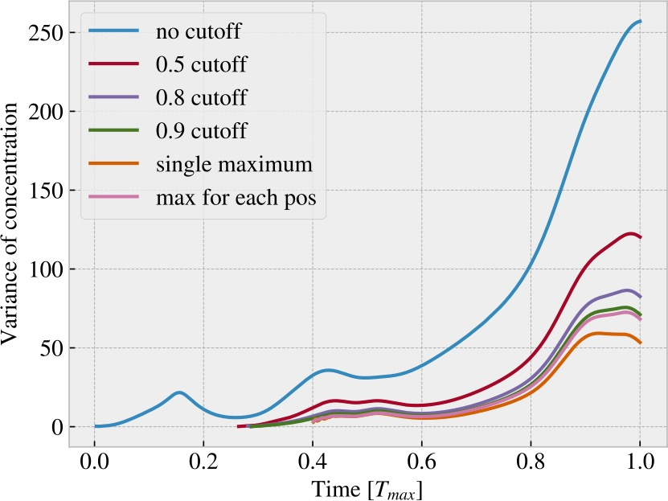
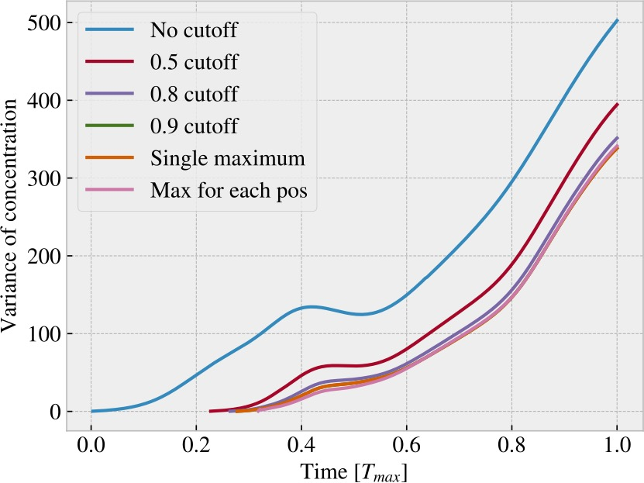
Variance of concentration
Pe = 150
Pe = 50
Just a property of the geometry. The consentration peak does not occur when the variance is reduced.
The behaviour is similar independent of injection method.

Slide 15
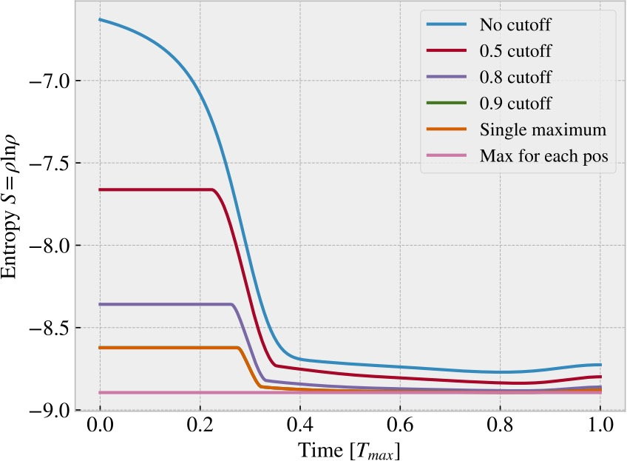
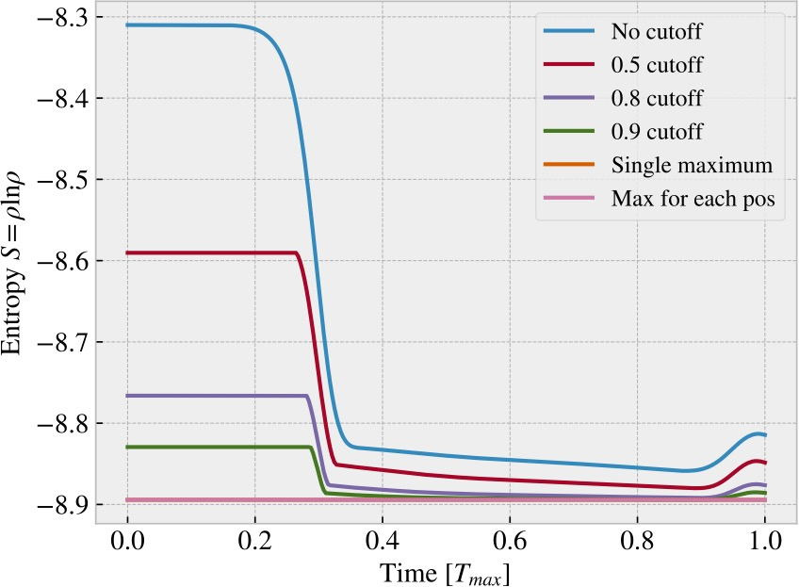
Entropy

Slide 16
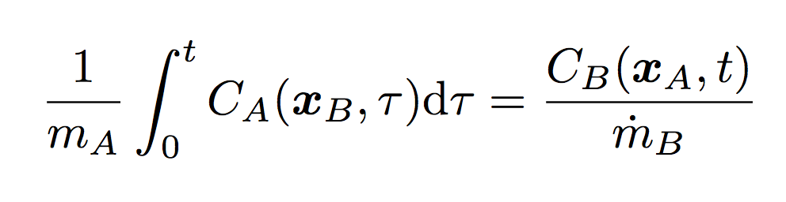
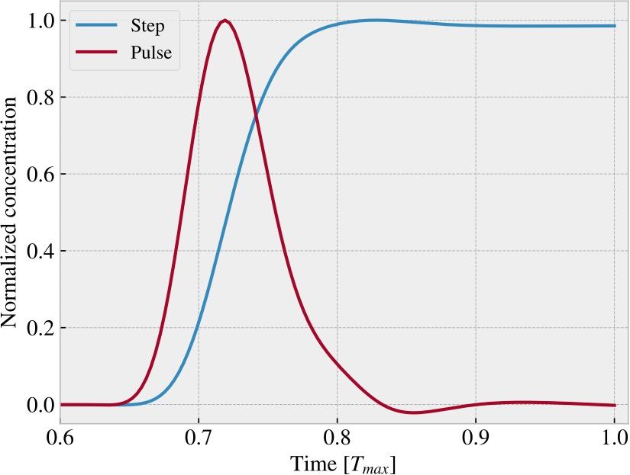
Heaviside step function injection

Slide 17
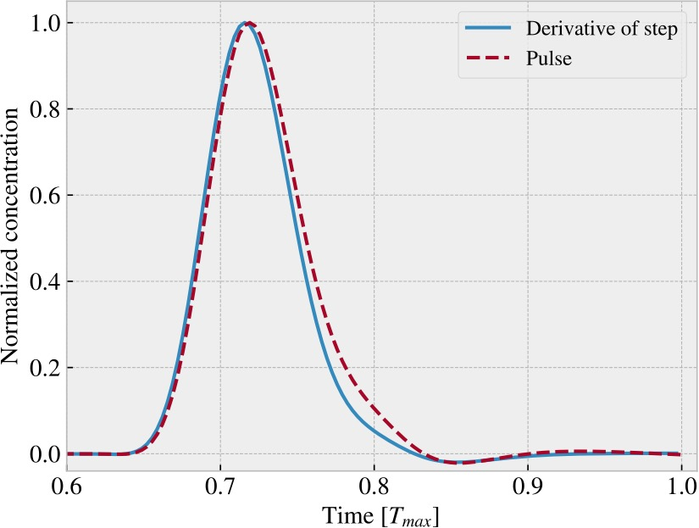
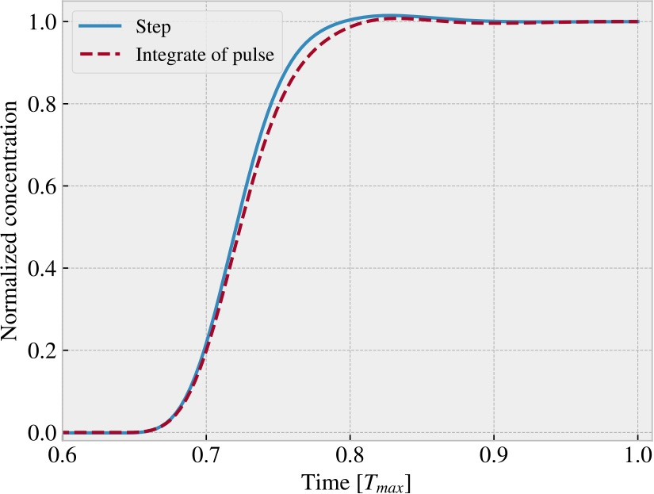
Heaviside step function injection
Re = 6.9 * 1e-3

